Slide 1
Workplace Factors and Mental Health Treatment: Insights from a Tech Industry Survey
An Exploratory Analysis of nearly 1,500 Tech Workers Using Python and Pandas By Shruti Sumadhur Ghosh — June 2025

Slide 2
Project Objective
This project aims to explore how various workplace and demographic factors influence employees' attitudes and behaviors toward mental health in the tech industry. Using survey data from approximately 1,500 respondents, the analysis seeks to:
Understand the relationship between employee background (e.g., family history, gender) and likelihood of seeking mental health treatment
Examine the impact of workplace factors such as anonymity, supervisor support, remote work, and access to benefits on mental health decisions
Identify patterns and predictors that can help organizations build a more mentally supportive work environment
Present findings using visualizations and insights that are accessible to non-technical stakeholders

Slide 3
Main Questions Explored:
How does mental health treatment-seeking vary across different countries and workplace environments?
What are the strongest predictors of whether an employee is likely to seek mental health support?

Slide 4
Methodology
This project analyzes survey data on mental health in the technology sector, containing approximately 1,500 responses across 27 columns. The analysis was conducted using Python, Pandas, and Matplotlib, and focused on:
Data Cleaning: Removed or corrected missing, inconsistent, or outlier values in fields such as age, gender, and timestamps.
Variable Selection: Identified key features such as family_history, anonymity, benefits, and supervisor as potentially influential on treatment-seeking behavior.
Exploratory Data Analysis (EDA): Used cross-tabulations and stacked bar charts to explore patterns between categorical variables.
Visualization: Created 7 percentage-based stacked bar charts to compare mental health treatment or attitudes against workplace factors.
Insight Generation: Summarized key findings based on observed trends and data distributions.

Slide 5
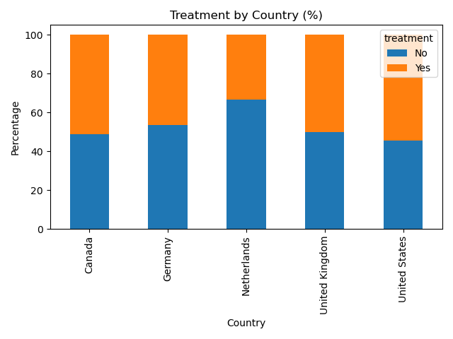
Treatment by country (%)
📊1. Treatment by Country: Employees from the United States and Canada report higher rates of seeking treatment, while those in the Netherlands are less likely to do so, indicating possible cultural or systemic differences in mental health support.

Slide 6
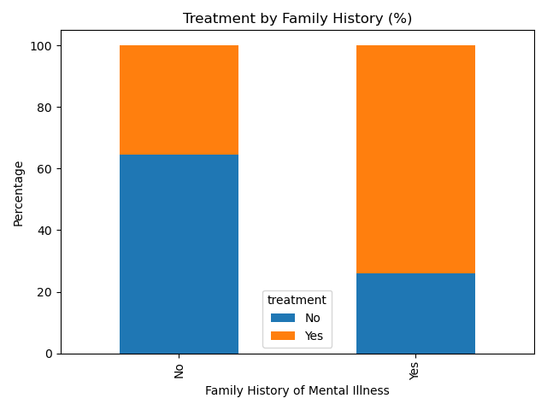
Treatment by Family History (%)
👨‍👩‍👧‍👦 2. Family History vs Treatment: Individuals with a family history of mental illness are about 3 times more likely to seek treatment than those without, highlighting the role of personal experience in encouraging mental health awareness.

Slide 7
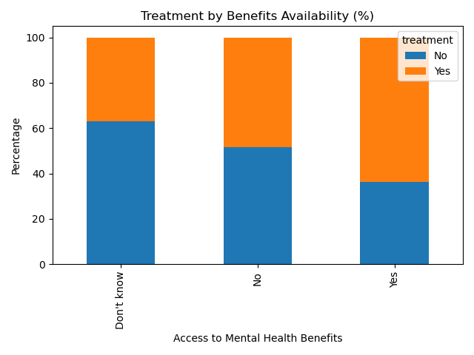
Treatment by Benefits (%)
🏢 3. Benefits vs Treatment:
Access to employer-provided mental health benefits significantly increases treatment-seeking. 64% of those with benefits sought help, compared to just 36% without.

Slide 8
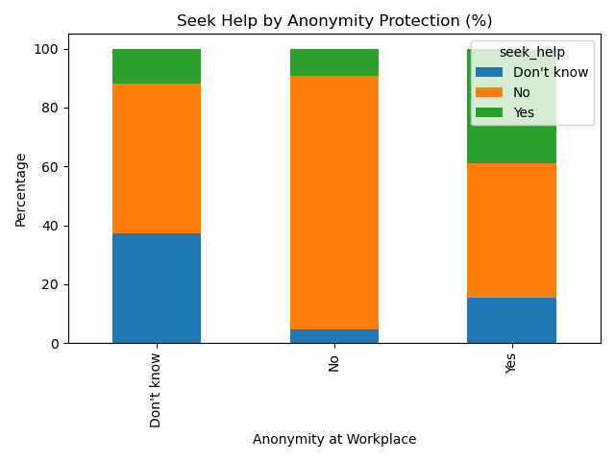
Seek Help by Anonymity (%)
🕶️ 4. Anonymity vs Seek Help: Trust in anonymity at the workplace dramatically increases help-seeking. Only 9.4% of those who felt anonymity was not protected sought treatment, versus 39% who did when it was protected.

Slide 9
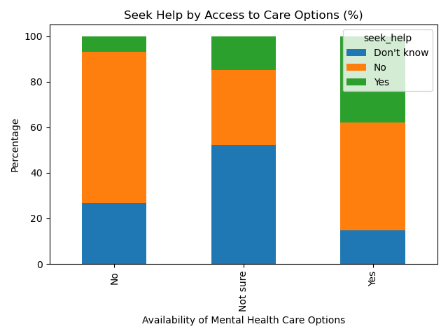
Seek Help by Care Options (%)
🧑‍💼 5. Supervisor Support vs Treatment:
Surprisingly, the comfort level with discussing mental health with a supervisor does not show a significant impact on treatment-seeking behavior. Other factors appear to play a stronger role.

Slide 10
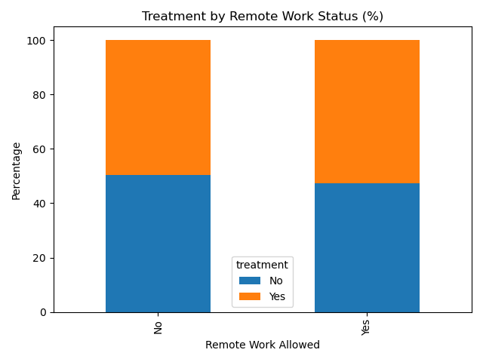
Treatment by Remote Work (%)
🩺 6. Care Options vs Seek Help:
Employees aware of available care options are 5x more likely to seek help. Those unaware or unsure were much less likely to respond positively.

Slide 11
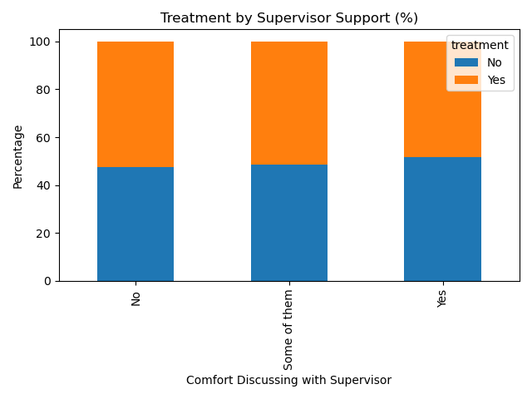
Treatment by Supervisor Support (%)
🏠 7. Remote Work vs Treatment:
Those allowed to work remotely were slightly more likely to seek treatment. While the difference is not dramatic, it suggests that flexible environments may encourage openness toward mental health.

Slide 12
Conclusion :
The strongest predictors of mental health treatment-seeking are family history, anonymity, and clear access to care and benefits. Organizations should prioritize not just providing support, but ensuring employees are aware of it and feel safe using it.

Slide 13
📌 Recommendations
Provide clear access to mental health benefits Ensure that employees are aware of and can easily access mental health coverage as part of their employment package.
Communicate the availability of care options Promote in-house or external counseling, therapy, or support services — especially in onboarding and wellness communications.
Protect and promote anonymity Build trust by ensuring confidentiality in mental health discussions and support-seeking.
Train managers to recognize and support mental health needs While supervisor comfort didn’t show a strong impact in this dataset, proactive support may improve outcomes over time.

Slide 14
Encourage a stigma-free culture Use campaigns, peer support, and leadership modeling to normalize mental health conversations at work.
Combine flexibility with mental health initiatives Remote work alone may not improve treatment-seeking, but pairing it with accessible care options can enhance overall well-being.
Pay special attention to employees with a family history of mental illness They are more likely to seek help and may benefit from targeted communication or support.

Slide 15
Thank you for your time and attention! I hope this analysis provides meaningful insights into how workplaces can better support mental health in the tech industry.
📧 Shruti Sumadhur Ghosh 📅 Submitted on: 27th June 2025 🔍 Mental Health in Tech – Survey Analysis

